Slide 1

Preliminary Findings for PowerCo

Slide 2
Background information
The BCG project team thinks that building a churn model to understand whether price sensitivity is the largest driver of churn has potential. The client has sent over some data and the AD wants you to perform some exploratory data analysis.
The data that was sent over includes:
Historical customer data: Customer data such as usage, sign up date, forecasted usage etc
Historical pricing data: variable and fixed pricing data etc
Churn indicator: whether each customer has churned or not

Slide 3
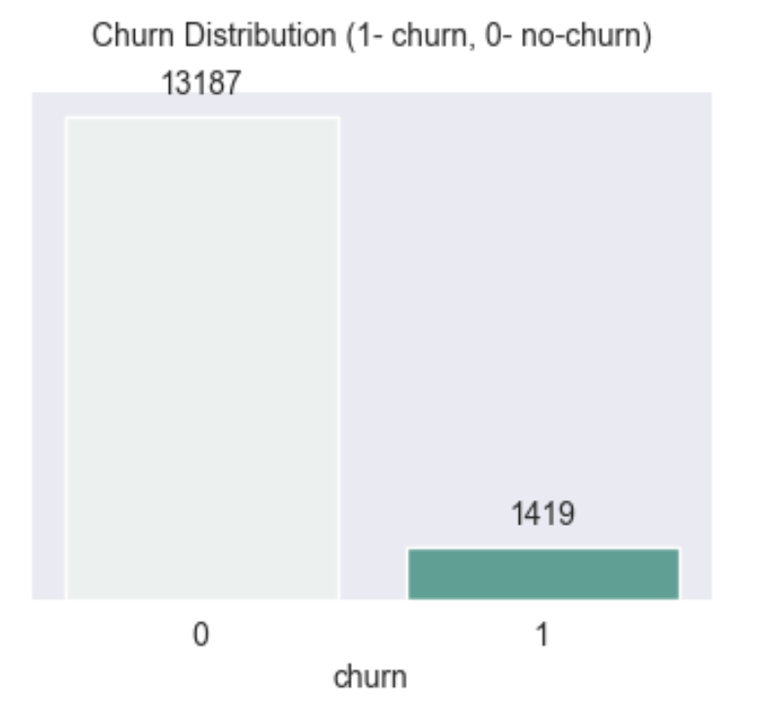
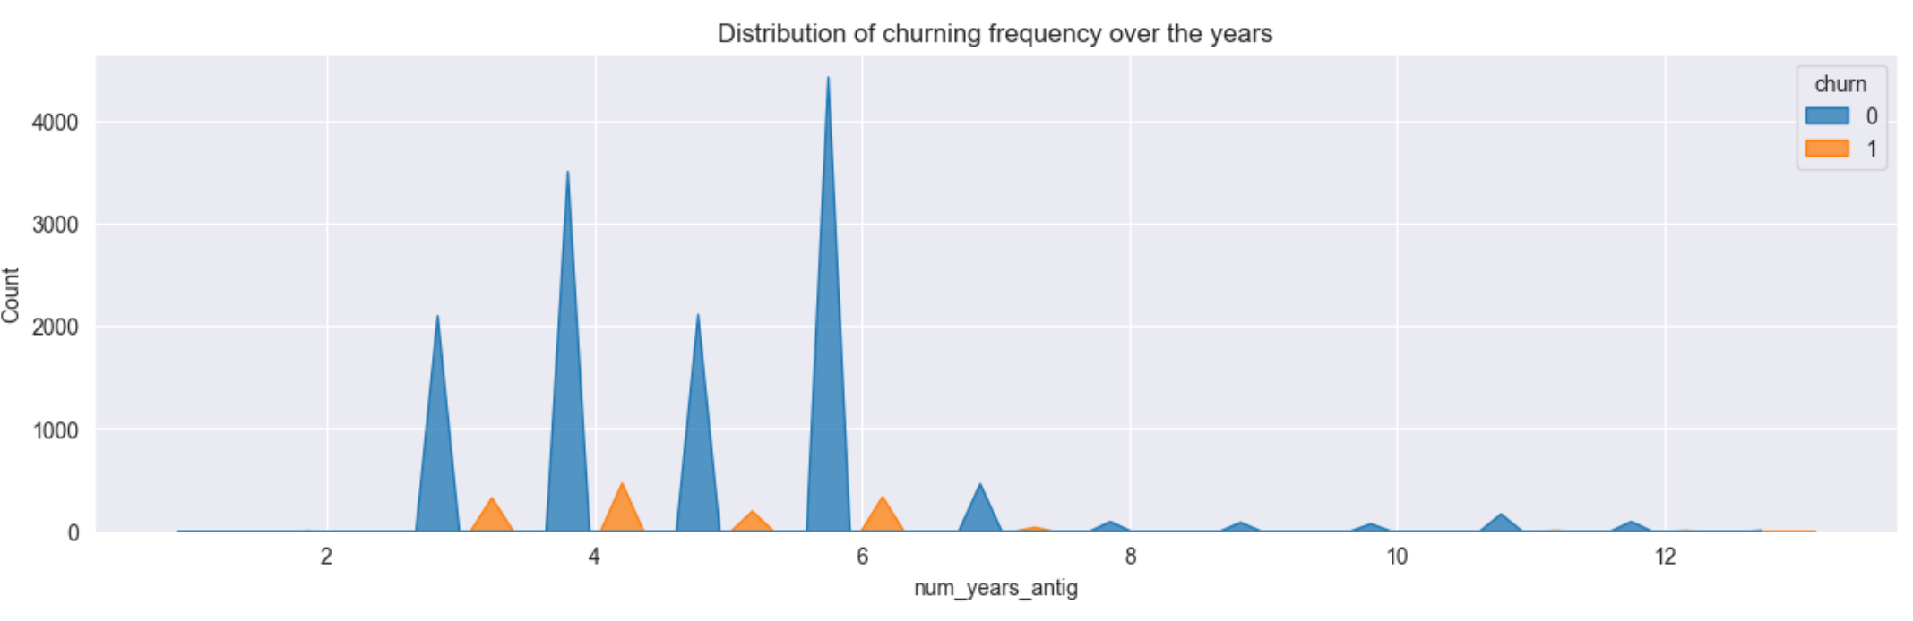
Exploratory Data Analysis
Churn Distribution
When the customers churn?
The target column is ‘Churn’ which has two unique values: 0 (no-churn) and 1 (churn). About 1419 customers which accounts for 9.72 % of the customers have churned and 90.28 % haven’t.
From the above plot, we can see that there is a rise of customers of churning at the initial period. If we can find out the price fluctuations or any other contributing factors of them leaving, we can possibly find a way to retain them.

Slide 4
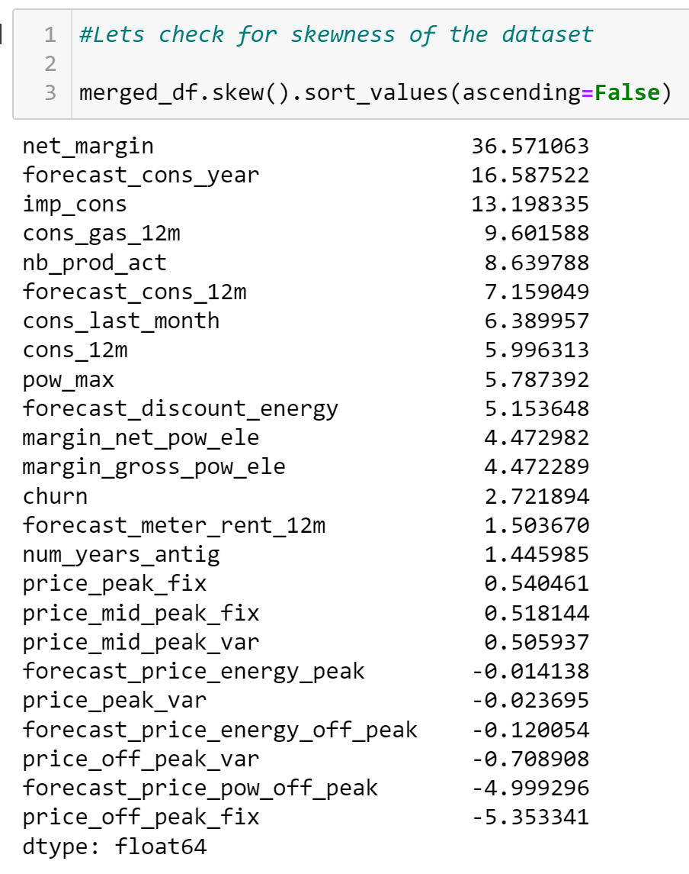
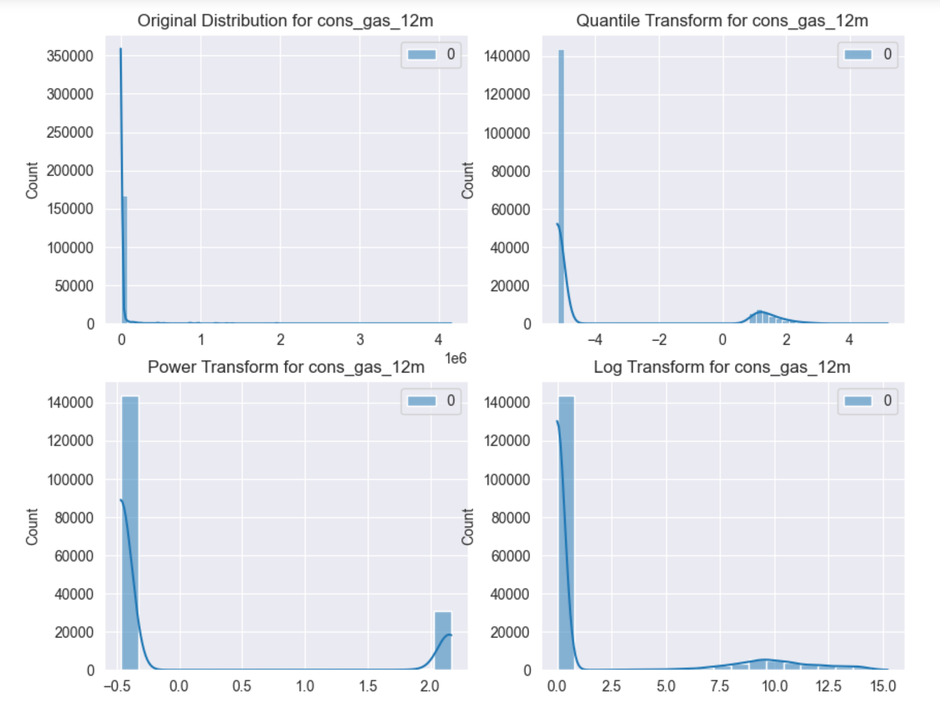
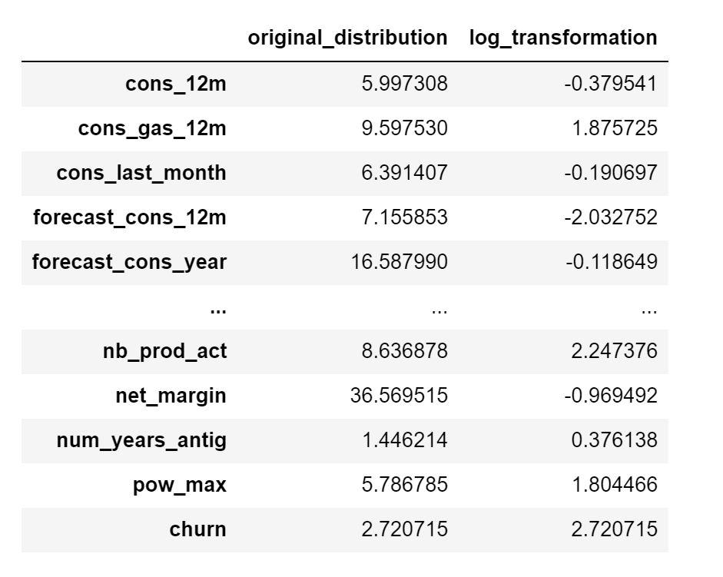
Exploratory Data Analysis
Skewness
Handling skewness
After log transformation
a
b
c
d
0 skewness = symmetrical distribution of values in row 1.
neg skewness = an asymmetry in the distribution corresponding to row 2 and the tail is larger towards the left hand side of the distribution.
Pos skewness = an asymmetry in the distribution corresponding to row 3 and the tail is larger towards the right hand side of the distribution.
The image above shows the different techniques in handling skewed data.
Chart a : original distribution
Chart b : Quantile transformation
Chart c : Power transformation
Chart d : Log transformation
The dataset is largely skewed, it will affect the performance of our model. This should be handled before attempting model development

Slide 5
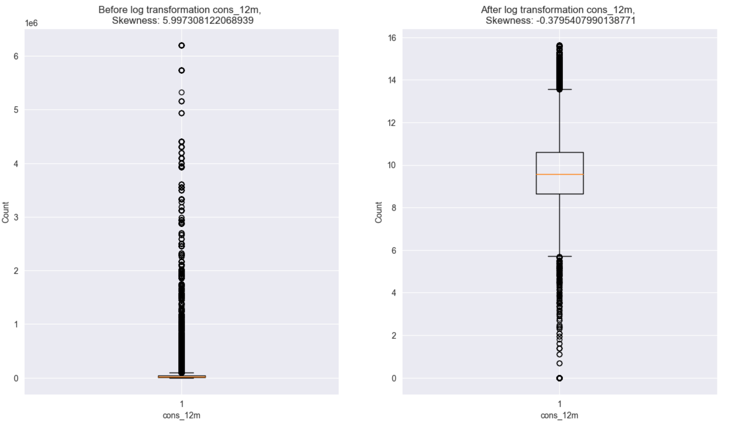
Exploratory Data Analysis
Visualizing the outliers, before and after handling skewness
A few points to keep in mind before handling the skewness:
Effects of skewed data:
Degrades the model’s ability (especially regression based models) to describe typical cases as it has to deal with rare cases on extreme values. ie right skewed data will predict better on data points with lower value as compared to those with higher values. Skewed data also does not work well with many statistical methods. However, tree based models are not affected.
To ensure that the machine learning model capabilities is not affected, skewed data has to be transformed to approximate to a normal distribution.

Slide 6
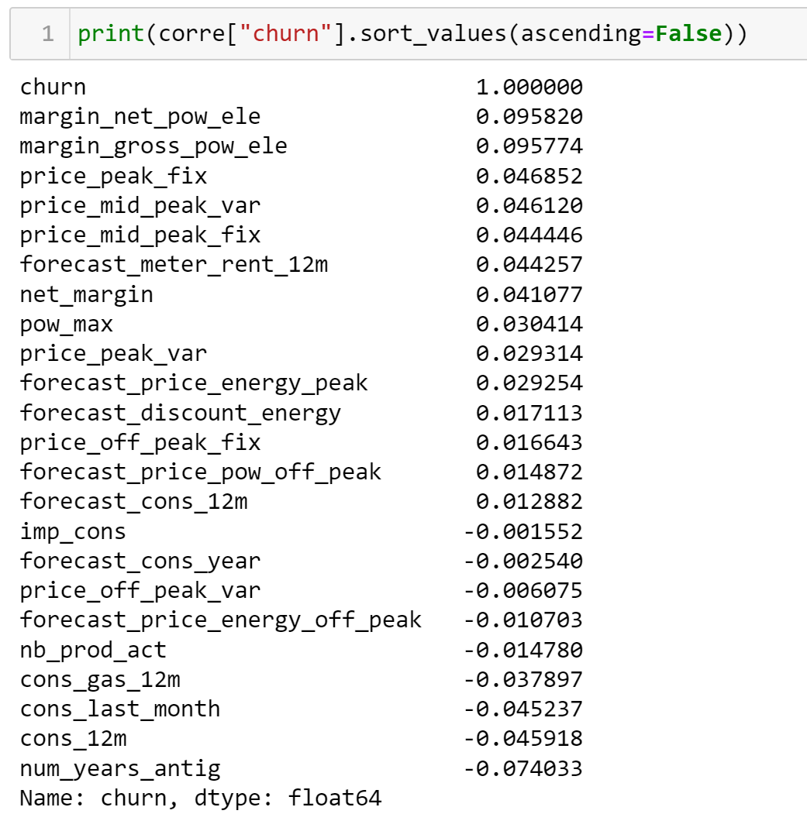
Exploratory Data Analysis
Exploratory Data Analysis
Correlation Analysis
Thumb of rule for Degree of correlation:
- Perfect: If the value is near ± 1, then it said to be a perfect correlation: as one variable increases, the other variable tends to also increase (if positive) or decrease (if negative).
- High degree: If the coefficient value lies between ± 0.50 and ± 1, then it is said to be a strong correlation.
- Moderate degree: If the value lies between ± 0.30 and ± 0.49, then it is said to be a medium correlation.
- Low degree: When the value lies below + .29, then it is said to be a small correlation.
- No correlation: When the value is zero.

Slide 7
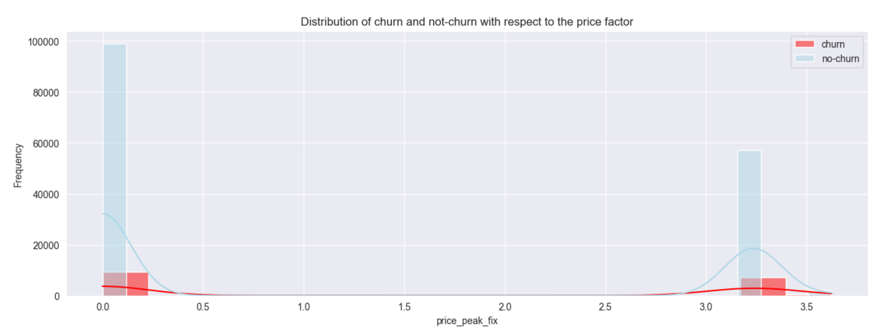
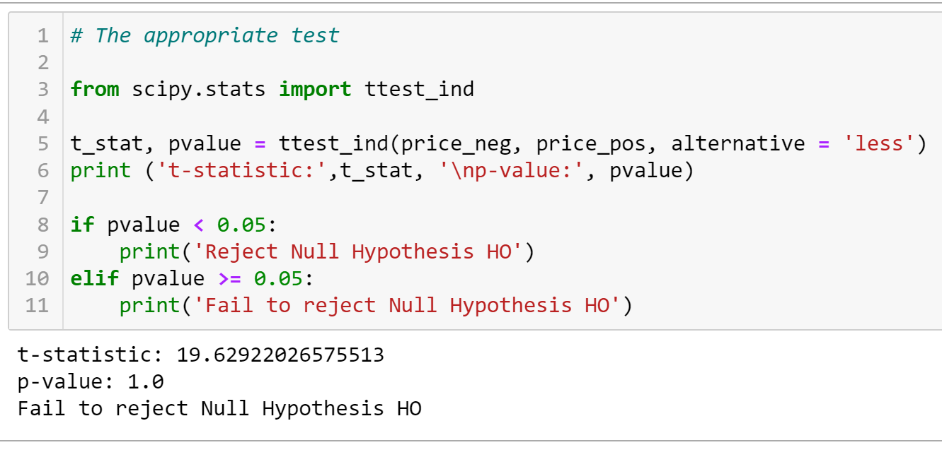
Exploratory Data Analysis
Hypothesis Testing
Define null and alternative hypothesis: Lets investigate a price factor which might or might not affect the customer's churning or not.
- H0 (null hypothesis): price change does not affect the churning of customers.
- Ha (alternative hypothesis): price change does affect the churning of customers.
It seems customer churning frequency happens at lower price as well as higher price fluctuations. It doesn't seem to be price related.
Conclusion :
There is no apparent relationship between the price and the rate of customers churning.

Slide 8
The End

